Slide 1

Distributed
System

Slide 2
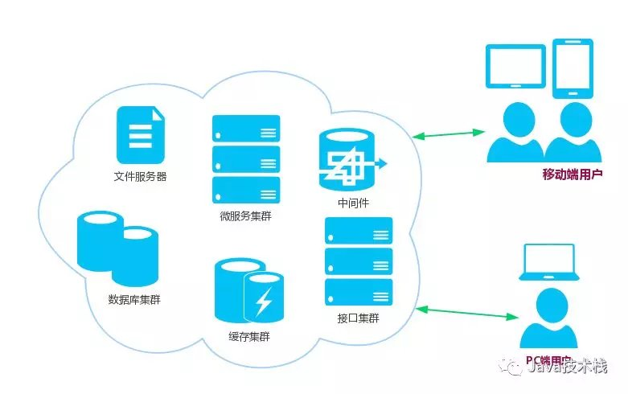
Definition
Computers are linked to a computing unit
Work together as to appear as a single computer
User doesn’t feel the logic or anything behind it
A shared state
Operate concurrently
Fail independently

Slide 3
Features
Cohesiveness
Couplings

Slide 4
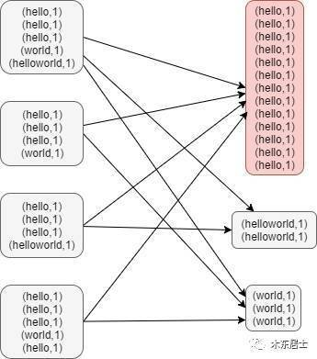
Principle
Hash Table- A Common Data Distribution Mode
Use id to calculate Hash value Usually we define x servers as a group Hash value/the number of groups, the remainder is denoted to the group number which deals the data
8
8
Data Skew
Group 1,the remainder is 0.
1
1
2
Group 2,the remainder is 1.
1
10
2
7
Group 3,the remainder is 2.
10
3
1
7
Group 4,the remainder is 3.
X=4
3

Slide 5
Advantages
All nodes are interconnected
Free to resize
easy to add nodes
Each node is independent
Multiple nodes share the same resource

Slide 6
Challenges
Security
Low fault tolerance
Difficulty in coordination and resource sharing
Overload
Lack of experience

